Slide 1
BIOMEDIN 215 Data Driven Medicine
Nigam Shah, MBBS, PhD
nigam@stanford.edu

Slide 2

Why care about inferential analysis?

Slide 3
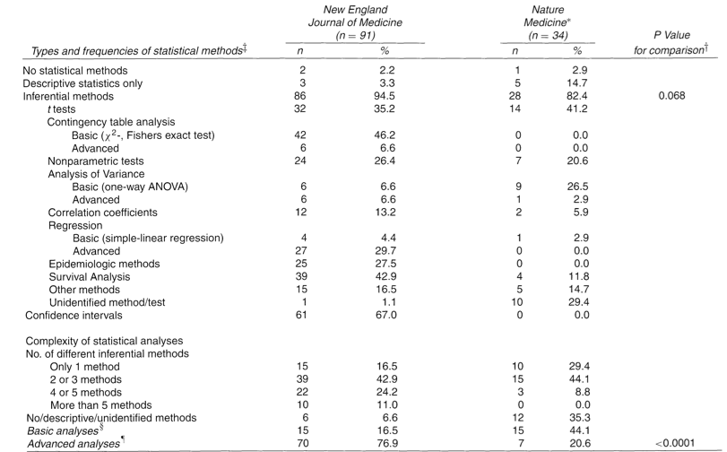
Why care about inferential analysis?
Strasak et al 2007. The use of statistics in medical research: A comparison of the “New England Journal of Medicine” and “Nature Medicine”. American Statistical Association 61(1): 47-55.

Slide 4
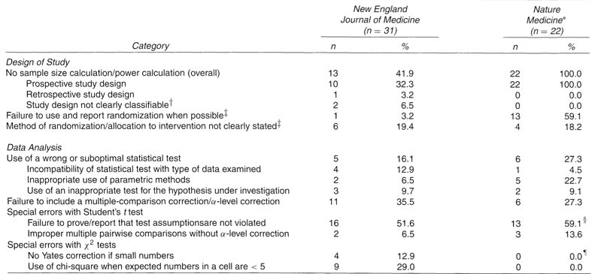
Why care about inferential analysis?
Strasak et al 2007. The use of statistics in medical research: A comparison of the “New England Journal of Medicine” and “Nature Medicine”. American Statistical Association 61(1): 47-55.
Notes:
There are many ways to go wrong, and all of them have been observed in top-ranking medical and primary science journals – you don’t want to end up a statistic! ;-)

Slide 5
Goals for today
Understand what is a statistical model
Understand how model fitting works
Understand confidence intervals and hypothesis testing
Learn to interpret findings in the context of the model

Slide 6
What is a model

Slide 7
Statistical inference
Aims to infer properties of a process or population given a smaller, observable sample
sampling,
probability
Data
x | y
0.12 | 12
… | …
19 | 1435
0.2 | 13
Data-generating process
inference
Can we use the data to ask:
How does the world work?
How sure are we?
Notes:
Associative analysis methods (aka measures of association) enable comparison between groups to determine if the observed incidence or prevalence of an event is statistically significant, that is significantly different from what would be expected by chance if the event was not at all associated with the factors you’re investigating.
Attribute MedStats

Slide 8
A statistical model is a set of assumptions about how the data are generated
sampling,
probability
Data
y
12
…
1435
13
Y ~ 𝒩(μ,σ²)

Slide 9
A model describes a family of probability distributions parameterized by the model parameters
Model
Y ~ 𝒩(μ,σ²)
Probability distributions in the model
parameters
P(y)
Equivalent parameterization:
Y = μ+ ε
ε ~ 𝒩(0,σ²)
y

Slide 10
A family of multivariate distributions
Model
Y ~ 𝒩(θx,σ²)
Probability distributions allowable by the model
θ
σ²
parameters

Slide 11

All models are wrong
“The idea that complex physical, biological or sociological systems can be exactly described by a few formulae is patently absurd.”
Real world
Deterministic process
Data
x | y
0.12 | 0
… | …
19 | 1
0.2 | 0
model
inference
Notes:
There are no parameters in the real world. There’s a ton of stuff going on. The variables you’re observing are generally not even physical quantities, but human labels on complex events (e.g. codes).
The model won’t really tell you anything about why things happen in the real world. It will just help you understand patterns and sort out what’s important

Slide 12
Why are our simple models often accurate?
Notes:
A bunch of drunk sailors start in the same place. Each second, they either take a step to the right or a step to the left. Where do they all end up?

Slide 13
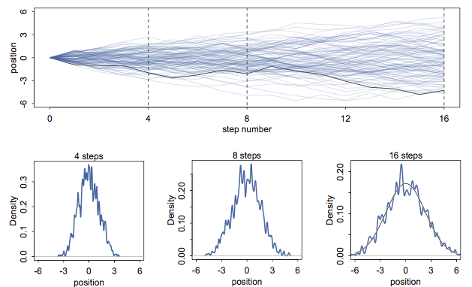
Why are our simple models often accurate?
Notes:
Central limit theorem

Slide 14
Fitting Models

Slide 15
Inference (model fitting) finds parameters that are likely, given the data and the model
Data
x | y
0.12 | 12
… | …
19 | 235
0.2 | 22
Y ~ 𝒩(θx,σ²)
inference
Maximum likelihood is a common and widely applicable way to do this

Slide 16
Given these parameters, how likely are the data?
Likelihood = 0.004
Data
Likelihood = 0.036
x | y
0.12 | 12
… | …
19 | 235
0.2 | 22
Y ~ 𝒩(-1x,0.5)
Likelihood = 0.09
Y ~ 𝒩(0x,0.5)
Y ~ 𝒩(1x,0.5)
…

Slide 17
Likelihood is a part of the model itself
Y is from a normal distribution with mean θx and variance σ²
Probability density function for normal distribution
Notes:
Do this on the board.

Slide 18
Finding the maximum likelihood parameters in jupyter notebook…
Notes:
Add screenshot slides in case notebook doesn't’t work
The maximum likelihood estimates (MLEs) are usually found using faster methods than grid search
For most models you can think of, R has software to do this for you

Slide 19
Inference picks the distribution from the family specified by the model that is most likely, given the data
θ
σ
Likelihood

Slide 20
For some common models, the MLE can be computed analytically:
Gaussian linear model with fixed σ²
Probability density function, given parameters
Log-likelihood function
Maximizing log-likelihood (convex)
is finding where derivative is zero
Calculate derivative, set to zero
Solve for parameter

Slide 21
How precise are our estimates?

Slide 22
The data vary, so our parameter estimate will vary too
Hypothetical
Data
x_{s} | y_{s}
0.12 | 12
… | …
19 | 1435
0.2 | 13
x_{s} | y_{s}
0.21 | 12.6
… | …
93 | 135
0.2 | 13
x_{s} | y_{s}
0.12 | 12
… | …
19 | 1435
0.2 | 13
x | y
0.12 | 12
… | …
19 | 1435
0.2 | 13
Estimate
Real World
^
sampling distribution of θ
^
θ

Slide 23
Can we figure out how much we expect our parameter estimate to vary?
Substitute something else in for the “real world” and calculate the sampling distribution
Substitute the model
Plug in fixed variables in the observed data
Substitute random draws from the observed data
Analytically
Analytical estimate
Parametric bootstrap
Bootstrap
Use to build confidence intervals and do hypothesis tests
Notes:
This is called the variance of the estimate

Slide 24
Using the analytical estimator and the model
Algebra and statistics + MLE estimator
Y ~ 𝒩(θx,σ²)
^
sampling distribution of θ
^
θ
Notes:
No simulation needed

Slide 25
Parametric bootstrap
Sample y from the estimated model, given x
Simulated
Data
x_{s} | y_{s}
0.12 | 12
… | …
19 | 1435
0.2 | 13
x_{s} | y_{s}
0.21 | 12.6
… | …
93 | 135
0.2 | 13
Y ~ 𝒩(θx,σ²)
x_{s} | y_{s}
0.12 | 12
… | …
19 | 1435
0.2 | 13
x | y
0.12 | 12
… | …
19 | 1435
0.2 | 13
^
x | y
0.12 | 12
… | …
19 | 1435
0.2 | 13
Random samples with replacement from x
MLE
^
Observed
Data
sampling distribution of θ
^
θ

Slide 26
(Nonparametric) bootstrap
Random samples with replacement from x, y
“Simulated”
Data
x_{s} | y_{s}
0.12 | 12
… | …
19 | 1435
0.2 | 13
x_{s} | y_{s}
0.21 | 12.6
… | …
93 | 135
0.2 | 13
x | y
0.12 | 12
… | …
19 | 1435
0.2 | 13
x_{s} | y_{s}
0.12 | 12
… | …
19 | 1435
0.2 | 13
x | y
0.12 | 12
… | …
19 | 1435
0.2 | 13
Observed
Data
Estimate
^
sampling distribution of θ
^
θ

Slide 27
Estimating the sampling distribution hands-on (jupyter notebook, for a deeper dive)
Notes:
Add screenshot slides in case notebook doesn't’t work

Slide 28
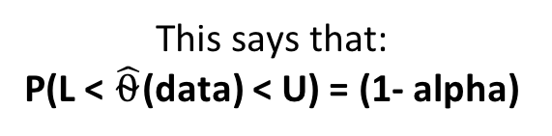
What is a confidence interval
This says that:
P(L < $\hat{⍬}$(data) < U) = (1- alpha)
Algebra lets us find values l and u
such that: P(l(data) < θ < u(data)) = (1-⍺)
(1-⍺)% of the probability mass
L = ⍺/2 quantile
^
θ
U = 1-⍺/2 quantile
That’s a confidence interval

Slide 29
With more data, the size of your confidence interval should... A) Grow B) Shrink Justify your answer for the analytical, parametric bootstrap, and nonparametric bootstrap estimators think-pair-share
Notes:
Add screenshot slides in case notebook doesn't’t work

Slide 30
Hypothesis Tests

Slide 31
Hypothetical
Data
x_{s} | y_{s}
0.12 | 12
… | …
19 | 1435
0.2 | 13
x_{s} | y_{s}
0.21 | 12.6
… | …
93 | 135
0.2 | 13
x_{s} | y_{s}
0.12 | 12
… | …
19 | 1435
0.2 | 13
x | y
0.12 | 12
… | …
19 | 1435
0.2 | 13
Estimate
Real World
^
sampling distribution of θ
^
θ

Slide 32
What if the “real world” were actually our model with θ = θ₀?
Hypothetical
Data
x_{s} | y_{s}
0.12 | 12
… | …
19 | 1435
0.2 | 13
x_{s} | y_{s}
0.21 | 12.6
… | …
93 | 135
0.2 | 13
Y ~ 𝒩(θ₀x,σ²)
x_{s} | y_{s}
0.12 | 12
… | …
19 | 1435
0.2 | 13
x | y
0.12 | 12
… | …
19 | 1435
0.2 | 13
Estimate
^
sampling distribution of θ given θ = θ₀
^
θ
Notes:
Often you can calculate the sampling dist. under the null analytically
There are also ways to do this with the bootstrap

Slide 33
How likely is our estimate if θ = θ₀ in the “real world”?
Estimate
x | y
0.12 | 12
… | …
19 | 1435
0.2 | 13
Observed
Data
sampling distribution of θ given θ = θ₀
^
θ
P-value: Probability of seeing an estimate of that size or more extreme given the null model
The p-value (like the confidence interval) only captures the effect of random sampling variation, not the effects of bias in sampling, misspecification of the model, etc.
Notes:
There are also ways to do this with the bootstrap

Slide 34
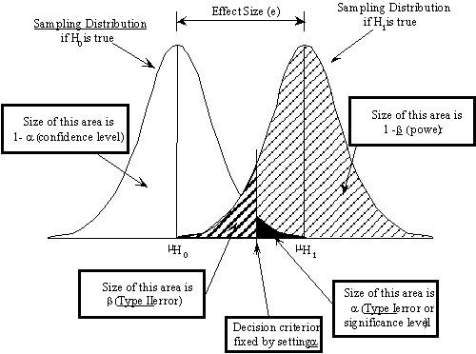
False negative
False positive
Notes:
Type 3 error = asking the wrong question.

Slide 35
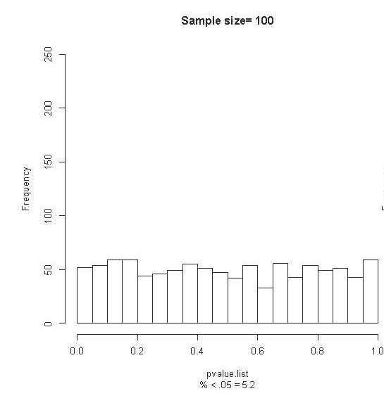
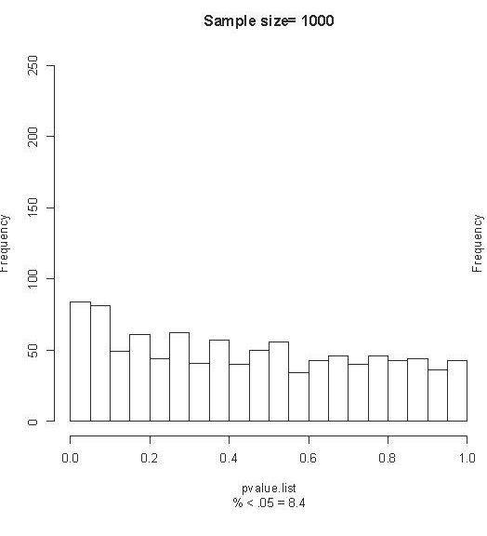
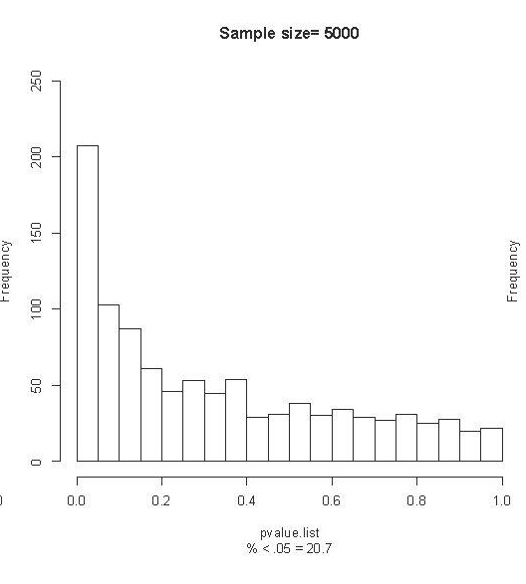
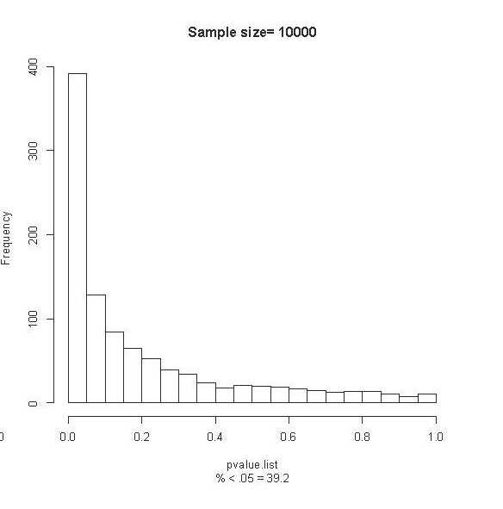
P-value, Power, Sample size
Must assess whether the magnitude of the difference is clinically relevant
Zimmerman N. A Computational Approach to Identification and Comparison of Cell Subsets in Flow Cytometry Data. Stanford University; 2011.
Notes:
There are 3 factors that affect the power of a statistic to identify differences: sample size, population variance and effect size.
If one fixes effect size and population variance for a given experiment and changes only the sample size, one can tweak the significance values to find significant differences in data that appears otherwise similar.
To illustrate this principle we compare two hypothetical patient groups (n=100,000 each), treated with placebo and drug. The outcome measure is systolic blood pressure, which differs between the two groups by 0.5%. We randomly sample k patients from each group and, using a two-sample t statistic, calculate a p value under the null hypothesis that there is no difference in systolic blood pressure between the two groups. This “trial” is performed with 1,000 random samples of size k from the original patient groups yielding a distribution of p-values.
Performing these trials over a range of values for k demonstrates the behavior of statistical significance in the presence of varying levels of evidence. When k=100, we only detect the modest difference between the two groups at an arbitrary threshold of statistical significance (p 0.05) 5.2% of the time. As we increase the size of k, the distribution of p-values shifts such that more and more trials become significant. In the final panel (k=10,000), 40% of the trials demonstrated statistically significant differences. A statistically significant difference absent in smaller trials suddenly reveals itself in the large trials.
Type I error – falsely rejecting the null hypothesis when there is no effect (this will happen 1 in 20 times when p-value threshold is 0.05)
Type II error – failing to reject the null hypothesis when there actually is an effect
Statistical power is the inverse of type II error – the chance of detecting a true effect if it exists
Studies typically aim for a power of 80% - meaning that researchers will miss a true effect 20% of the time
Power = how often will you not make a type II error
You never really know your power, but you can estimate it based on what you think the effect is and what your model is

Slide 36
Statistical significance, magnitude of effect, type-S and type-M errors
θ is never exactly equal to θ₀! In fact, θ probably doesn’t exist in the real world! The null hypothesis is never exactly true, so with enough data you can always confidently disprove it.
No magic at p=0.05
But you will still make mistakes:
“Type M Errors” (magnitude): You are confident that θ is big when it is really small, or vice versa
“Type S Errors” (sign): You are confident that θ is positive when it is really negative, or vice versa
http://andrewgelman.com/2004/12/29/type_1_type_2_t/
Notes:
Give examples: This matters (when it doesn’t) or this helps (when it hurts)
There is pretty much no attention paid to quantifying these kinds of errors in the statistics literature

Slide 37
What did we learn:
A statistical model is a set of assumptions about how the world works which defines a class of possible data-generating probability distributions
Model fitting is picking the distribution that’s most likely to have generated the data you see
Confidence intervals and hypothesis testing are ways to quantify variation in our estimate that comes from the randomness of sampling the data
Interpret findings in the context of the model

